Slide 1

Ignite: Your Ultimate Online Fitness Platform
Welcome to Ignite, a cutting-edge online fitness training platform developed by Team Pinaka and designed to empower users, trainers, and administrators alike. Our mission is to provide a seamless, engaging, and effective fitness journey for everyone.
Notes:
1

Slide 2





What is Ignite?
Ignite is more than just a platform; it's a comprehensive ecosystem for health and wellness. Users can access personalized workout plans, diligently track their progress, and interact directly with professional trainers. Administrators ensure a smooth operation by managing users and curating content.
Workout Plans
Progress Tracking
Access a diverse library of expertly crafted routines.
Monitor your fitness journey with detailed visual insights.
Trainer Interaction
Connect with certified trainers for personalized guidance.
Notes:
2

Slide 3
Key Players in the Ignite Ecosystem
Our platform is built around three distinct user roles, each with tailored functionalities to ensure a holistic and efficient fitness experience.
1
2
3
Administrators
Trainers
Users
Oversee the entire platform, managing user accounts, content, and system settings to maintain optimal performance.
Craft and deliver personalized workout plans, engage with users, and track their progress to foster growth.
Access a wealth of workout content, track their fitness milestones, and receive support from dedicated trainers.
Notes:
3

Slide 4
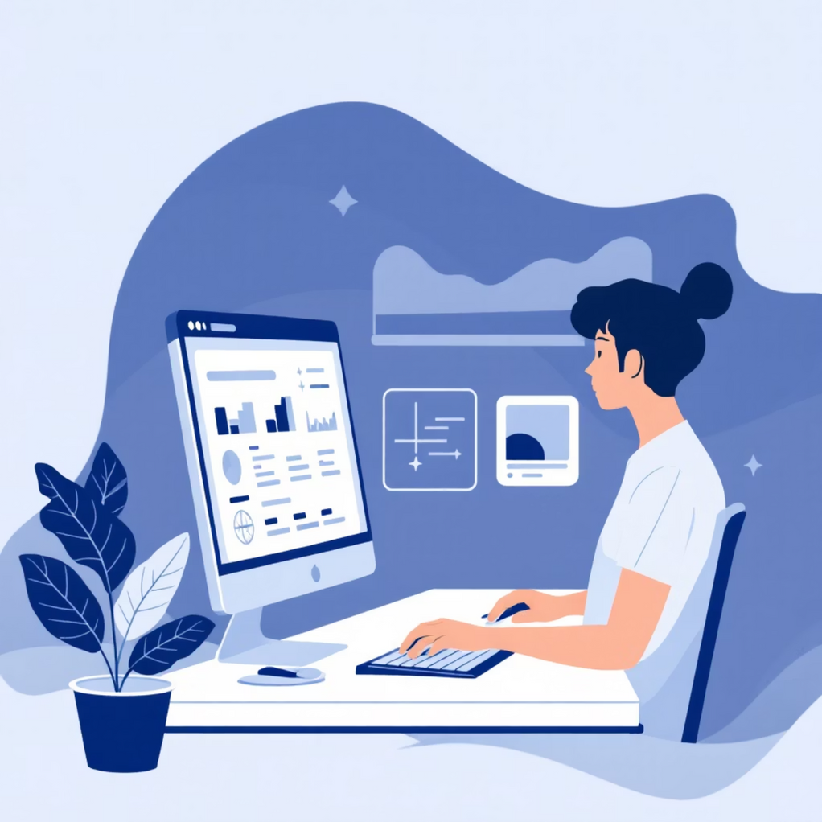
Administrator Power: Seamless Platform Management
Administrators are the backbone of Ignite, ensuring everything runs smoothly. Their tools are designed for efficiency and control.
User Management
Create, update, and delete user accounts with ease, controlling access and roles.
Content Approval
Approve or reject workout plans and videos submitted by trainers, maintaining quality standards.
System Settings
Configure global platform settings, ensuring a consistent and optimized user experience.
Notes:
4

Slide 5
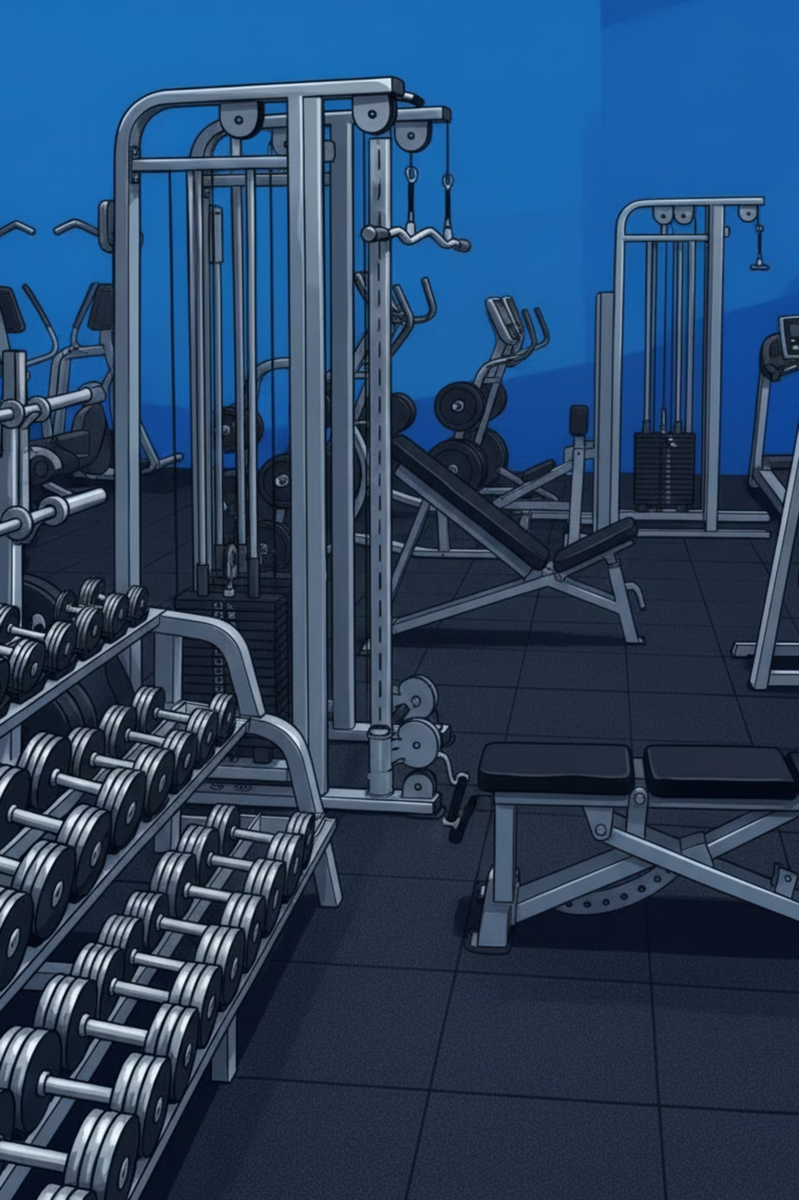



Trainer Toolkit: Empowering Fitness Professionals
Ignite provides trainers with powerful tools to create engaging content, interact with their clients, and track progress effectively.
Workout Plan Creation
Design detailed workout routines, set schedules, and publish them for users.
User Interaction
Communicate directly with users, provide feedback, and answer questions.
Progress Tracking
Monitor user fitness data and generate insightful progress reports.
Notes:
5

Slide 6
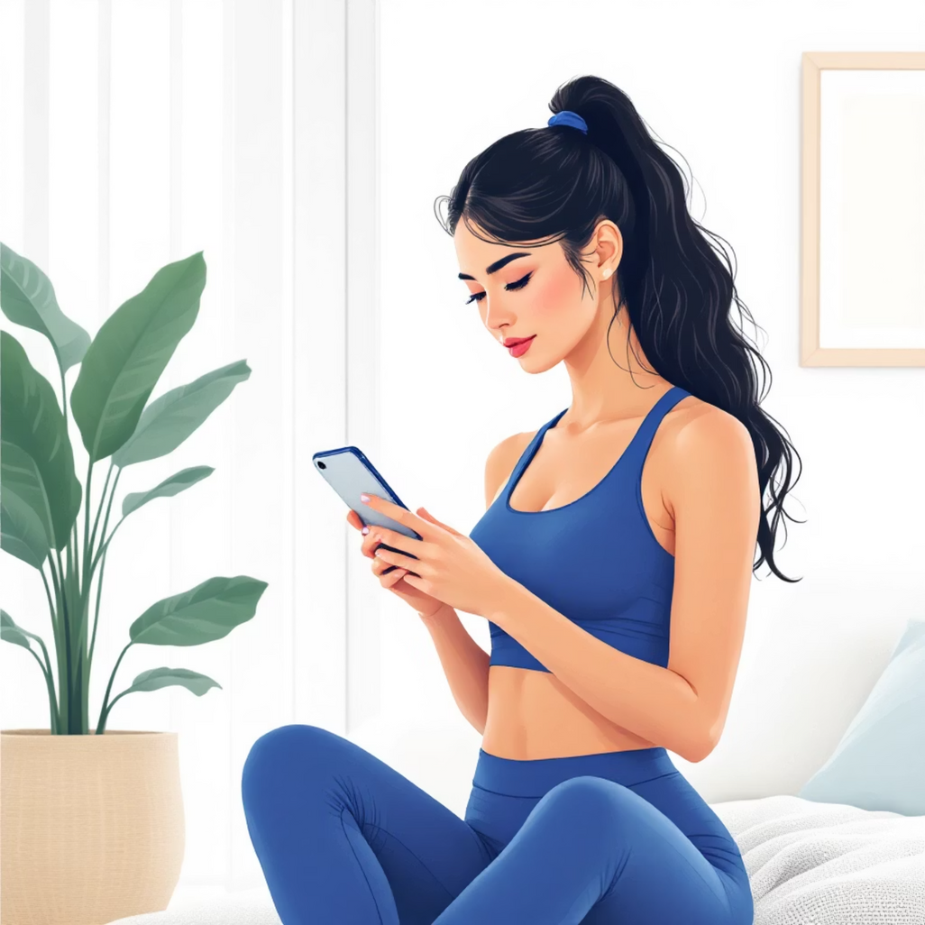
User Experience: Your Fitness Journey, Simplified
For users, Ignite offers an intuitive interface to access plans, monitor progress, and connect with trainers, making fitness achievable and enjoyable.
Access Workout Plans
Browse and select from a variety of workout plans tailored to your goals.
Track Fitness Progress
Log your weight, measurements, and performance to visualize your journey.
Interact with Trainers
Send messages, receive feedback, and get personalized support from your trainer.
Notes:
6

Slide 7

Admin Dashboard: Command Center for Control
The administrator dashboard provides a comprehensive overview and control panel for the entire Ignite platform.
User Management
1
A dynamic table to create, edit, or delete user accounts and manage roles.
Content Management
2
Monitor all workout plans and videos with their current approval status.
System Settings
3
Dedicated panel for configuring system-wide settings and tracking update statuses.
Performance Analytics
4
Visual charts illustrating user engagement and the effectiveness of various content.
Notes:
7

Slide 8

Trainer Dashboard: Your Coaching Hub
The trainer dashboard is meticulously designed to support trainers in their coaching journey, providing all necessary tools at their fingertips.
Workout Plan Management
View and modify all created workout plans and their current publication statuses.
User Interaction History
Access a detailed log of all communications, messages, and feedback exchanged with users.
Progress Tracking
Visualize user progress reports and identify trends to optimize coaching strategies.
Content Upload Status
Manage and review the status of all uploaded workout content.
Notes:
8

Slide 9

User Dashboard: Personalized Fitness at Your Fingertips
The user dashboard is your personalized portal to all things fitness, designed for easy navigation and motivation.
1
Workout Plans
Explore available workout plans and dive into detailed descriptions to find your next challenge.
2
Fitness Progress
See your journey unfold with graphical representations of your fitness goals and achievements.
3
Interaction History
Review past conversations and feedback from your trainers, keeping track of your guidance.
4
Plan History
Keep tabs on your completed and in-progress workout plans, celebrating every milestone.
Notes:
9

Slide 10








Ignite: Fueling Your Fitness Future
Ignite is set to transform the online fitness landscape, providing an unparalleled experience for all stakeholders. Join us in building a healthier, more connected world.
Integration
Innovation
Seamlessly connecting users, trainers, and administrators.
Continuously evolving with new features and content.
Reach
Impact
Expanding access to expert fitness guidance worldwide.
Driving real fitness results and fostering a vibrant community.
Notes:
10

Slide 11
Meet Team Pinaka
Pinaka is the innovative team behind Ignite, driving its mission and innovation forward. Get to know the visionary leaders.
Anuj Kumar Sharma
Geetika Agarwal
AI/ML Student
AI/ML Student
Anuj is a visionary leader and a B.Tech student in AI and ML at Galgotias University, applying his academic insights to build innovative fitness technology solutions for engaged communities.
Geetika is an accomplished technical architect and a B.Tech student in AI and ML at Galgotias University, driving Ignite's innovative platform development with a strategic technological vision grounded in artificial intelligence and machine learning.
Notes:
11

